Slide 1
Paid advertising campaign of bags world
objective.; brand visibility

Slide 2

Brand visibility
TARGET AUDIENCE;
Demographics: Women, ages 18-45, income level, working professionals, students, and fashion enthusiasts.
Geographics: Urban areas, specific countries/regions if applicable.
Psychographics: Interests in fashion, accessories, social media trends, influencers.

Slide 3
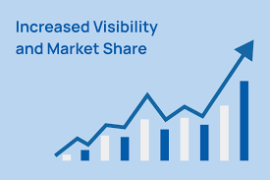
SPECIFIC GOALS
Visibility: Increase brand reach by 10% over a specified time period (e.g., 3 months).
Engagement: Boost interactions (likes, comments, shares) on ads by 8%.Conversions:
Track website visits, product page views, and sales generated through ads.
INCREASE Communication with your surroundings tell them about your product

Slide 4
Platform strategy
Ad Platforms & StrategyFacebook & Instagram Ads (Meta)
:Visual Ads: Showcase bags through lifestyle imagery, influencer endorsements, or videos.
Ad Formats: Carousel (multiple bags in a single ad), video ads (demonstrating bags), collection ads (to display an entire range)
.Targeting: Leverage detailed targeting based on interests, shopping behaviors, and custom lookalike audiences.Google Ads (Display & Search)
:Search Ads: Bid on keywords related to bags (e.g., “best women’s bags,” “trendy handbags”)
.Display Ads: Use banner ads on fashion and shopping websites.Pinterest Ads:Visual Discovery:
Use Pinterest to target women seeking fashion inspiration. Use rich pins to display prices and drive traffic.

Slide 5
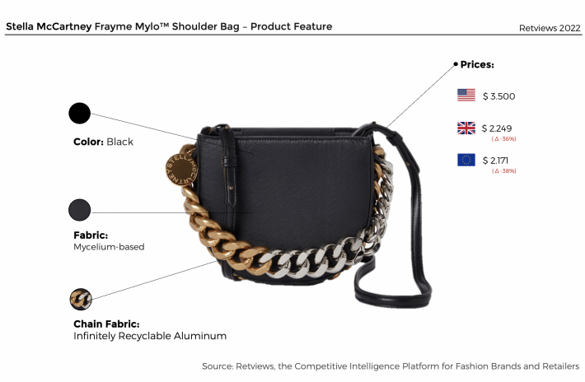
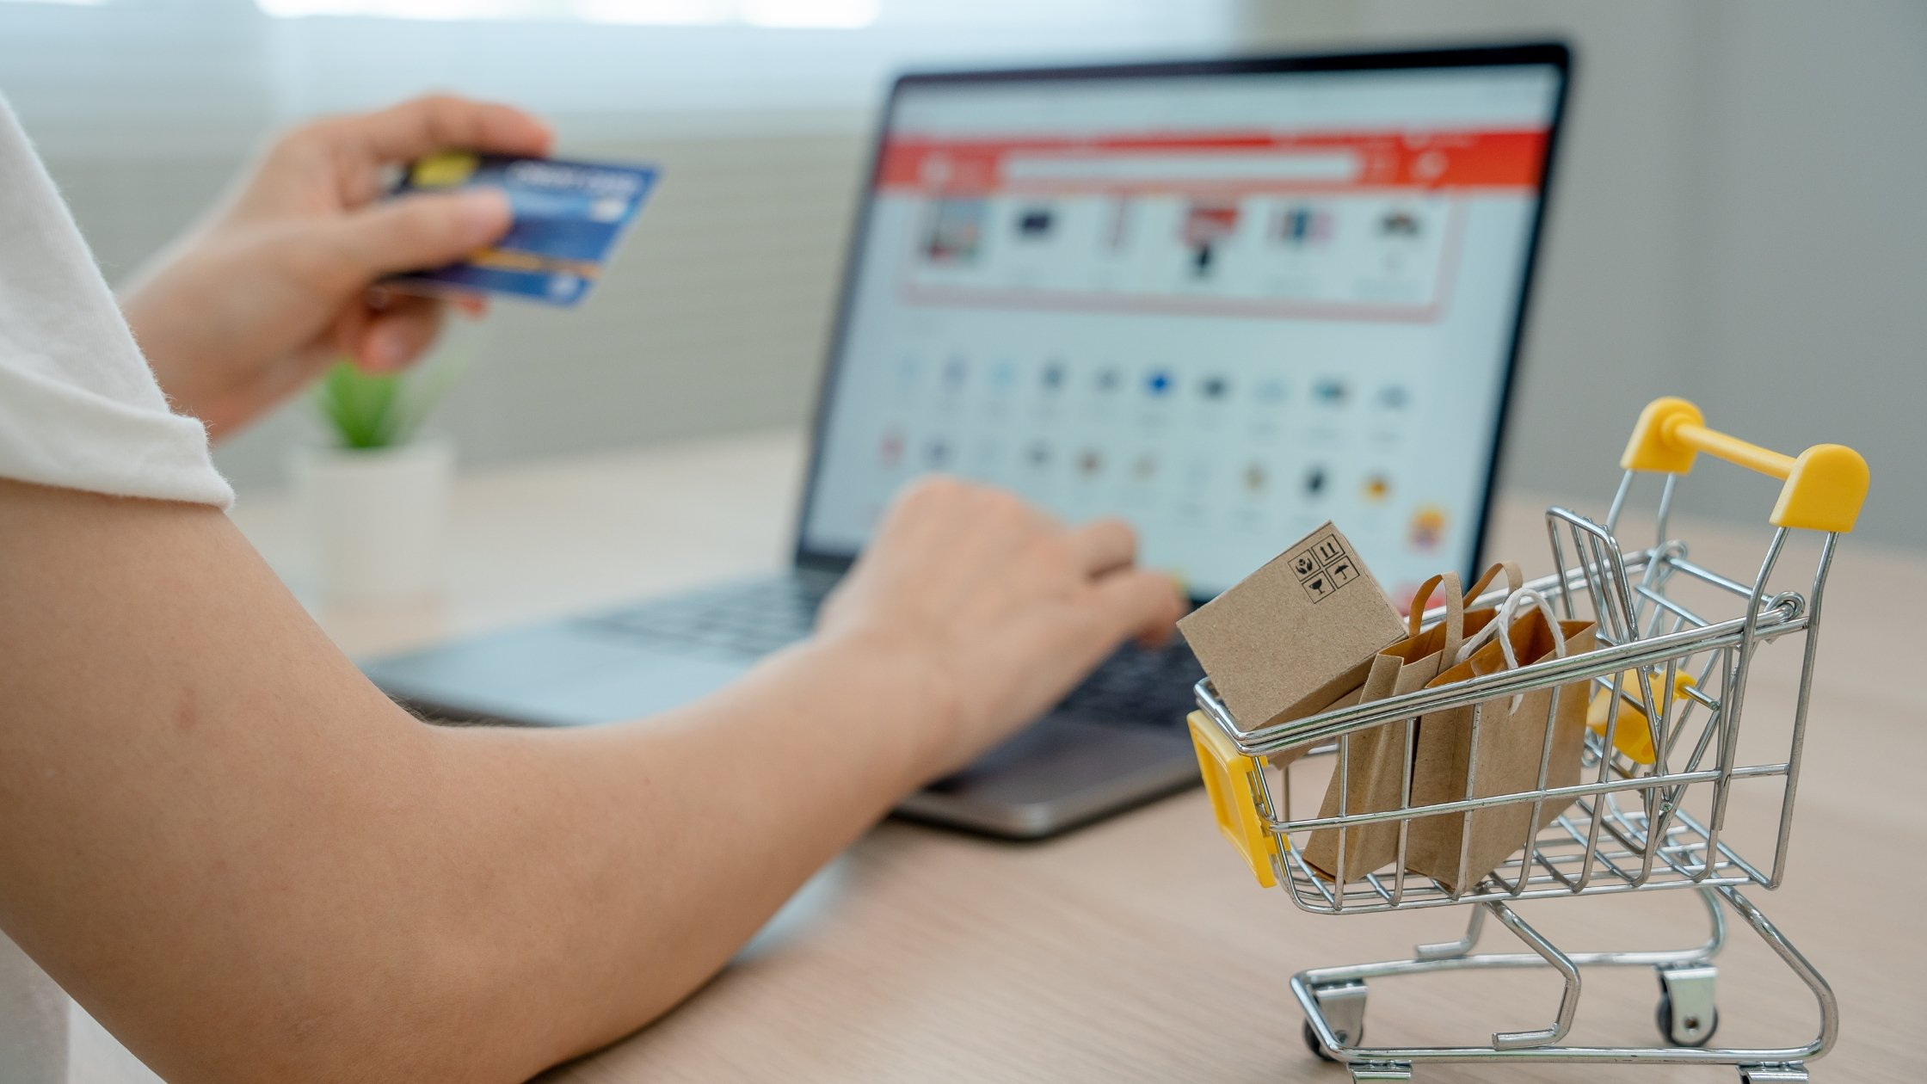
Intention pictures

Slide 6
Budgeting
Budget & Bidding StrategyDaily/Monthly Budget: Allocate a specific budget for each platform. Prioritize the platform with better performance.
Bidding: Use a mix of manual and automated bidding based on objectives (CPC for engagement, CPA for conversions).
Budget allocation for paid ads ;
Total budget ; 50000
Social media ads ; 15000
Influncers ;15000
Other expense 10000( ex; PR packages delievery riders fees etc)
Remaining 10000 as for emergency cost ;

